Slide 1

Most Required Skills For : Data Analyst
Web Scraping & Data analysis Project

Slide 2
What are the most required skills to work as a Data Analyst?
Many of the Beginners in Data Analysis field are confused by This Question
This Project is answering this by analyze 75 Job offers Scraped from Wuzzuf Website
Link with all files (Github)

Slide 3
Tools Used :
1. Web Scraping : Python (Selenuim)
2. Data Preparations : Python (Pandas, Numpy)
3. Visualizations : Python (Matplotlib)

Slide 4
The Skills is categorized by :
Technical Skills
Soft Skills
Analytical Skills
Qualifications
Domain Knowledge

Slide 5
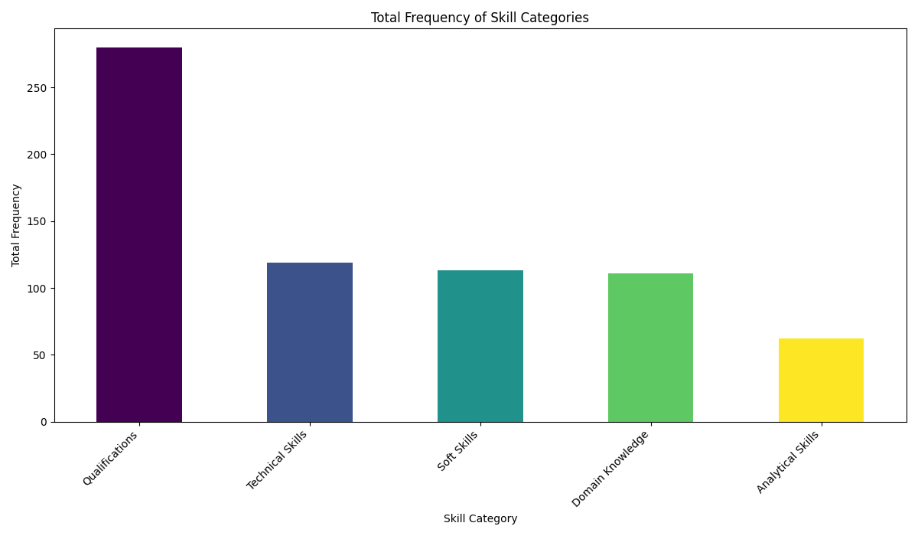
The Most words or skills is mentioned in Job offers is :
Qualifications needed for the Job
Technical Skills
Soft Skills
Domain Knowledge
Analytical Skills

Slide 6
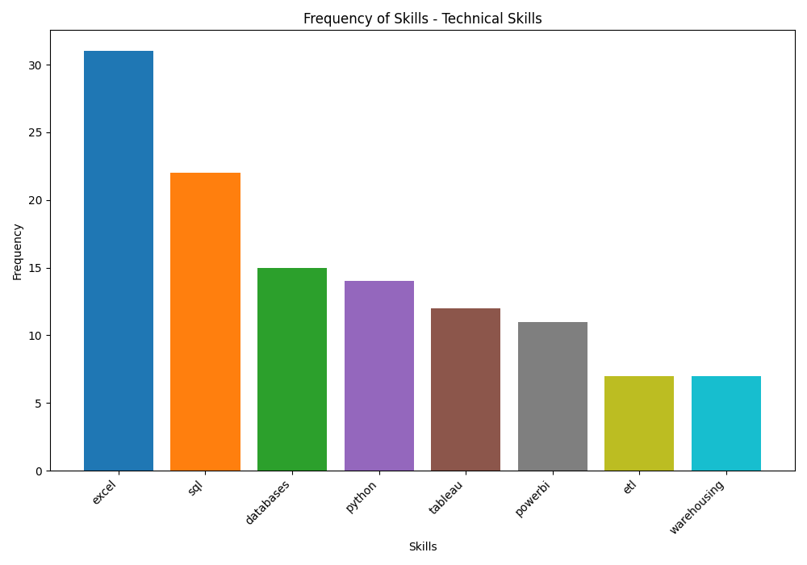
The Most Technical skills is mentioned in Job offers is :
Microsoft Excel
SQL
Database Management
Python
Tableau
Microsoft PowerBI
ETL Process
Warehousing Management

Slide 7
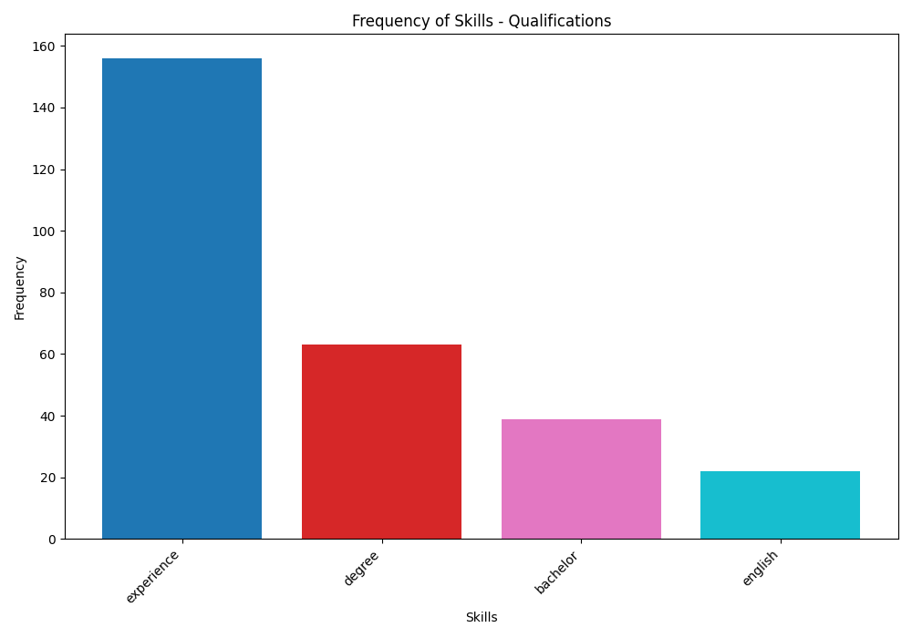
The Most Word mentioned across all skills and in job offer is :
Experience
Bachelor Degree is also Needed in most Jobs Offers
English

Slide 8
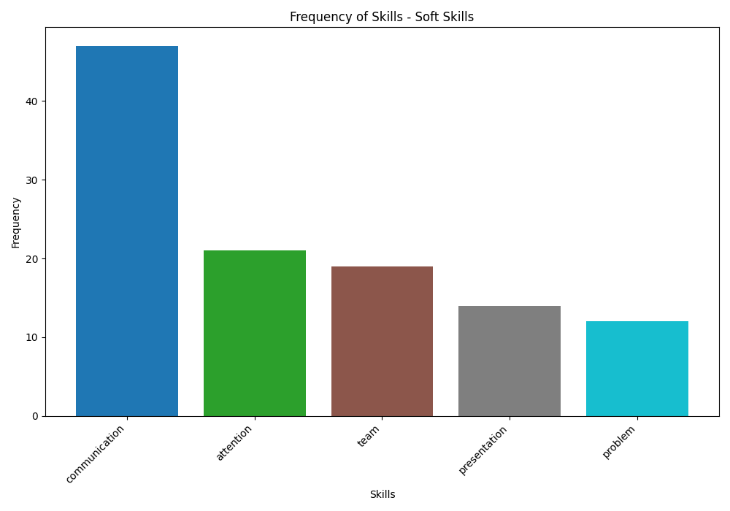
Soft Skills :
Communication
Attention to details
Working in a team
Making Presentation
Problem Solving

Slide 9
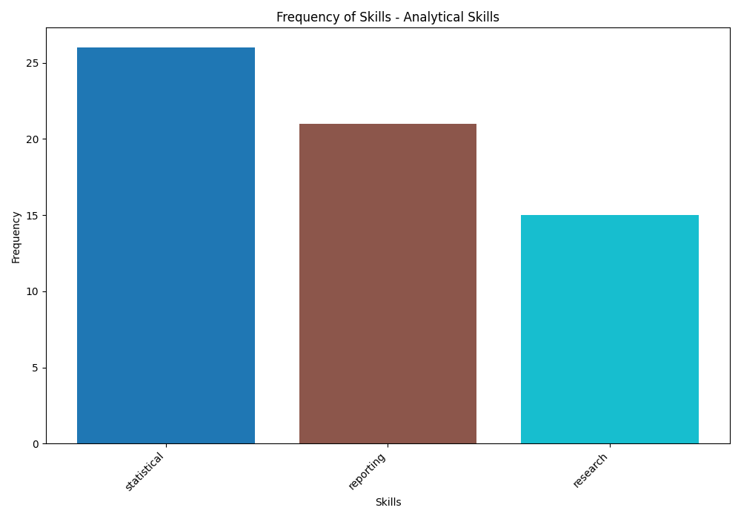
Analytical Skills :
Statistics
Reporting
Making Research

Slide 10
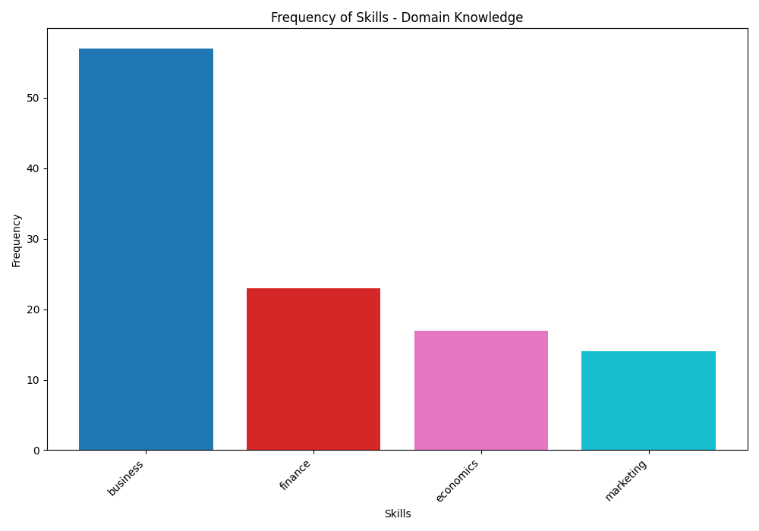
Domain Knowledge :
Business Knowledge
Finance Knowledge
Economics Knowledge
Marketing Knowledge

